Slide 1
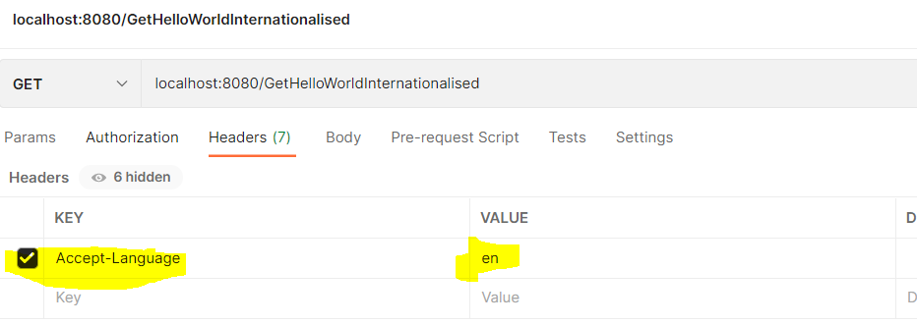
Accept-Language Header Request Parameter
The users can specify in header what language they are expecting in headers
If you go to LOCALE class, you will see that this is in Java util and you would see that there are a lot of locals which are supported English, French, German, Italian, Japanese.
What I would rather do is I would create property files where I would store this information. I would pick the value from this property files and return them back..
The format for naming properties file in messages_EN.properties.

Slide 2
There are 2 ways in Java to do internationalization
1.Using Locale as Request Parameter
2.Getting Locale using LocaleContextHolder.getlocale() class
Second method is better than first one as we don’t have to unnecessary use Parameter in our rest Api Method

Slide 3
Method1
// THis is a feature provided by Spring Boot to pickup messages from properties
// file
@Autowired
private MessageSource messageSource;
// Internationalization Example
// challenges to this approach is that we need to add locale parameter
@GetMapping(path = "/GetHelloWorldInternationalisedMethod1")
public String getHelloWorldInternationalisedMethod1(
@RequestHeader(name = "Accept-Language", required = false) Locale locale) {
return messageSource.getMessage("Hello", null, locale);
}

Slide 4
Method 2
// Internationalization Example2 , without using Locale as Header
@GetMapping(path = "/GetHelloWorldInternationalisedMethod2")
public String getHelloWorldInternationalisedMethod2() {
return messageSource.getMessage("Hello", null, LocaleContextHolder.getLocale());
}

Slide 5
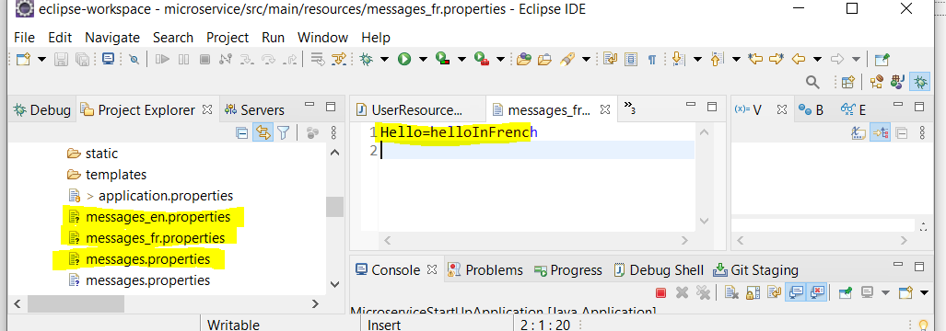
Properties file Sample
There should be one default messages.properties , otherwise we will get an error

